Slide 1
Kenall’s tau
Subsitution Matrices

Slide 2
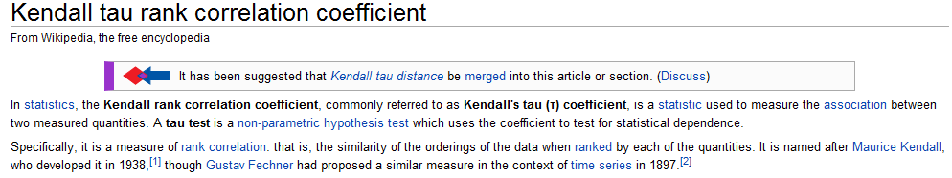
Kendall Rank Correlation – A non-parametric alternative to linear regression
http://en.wikipedia.org/wiki/Kendall_tau_rank_correlation_coefficient

Slide 3
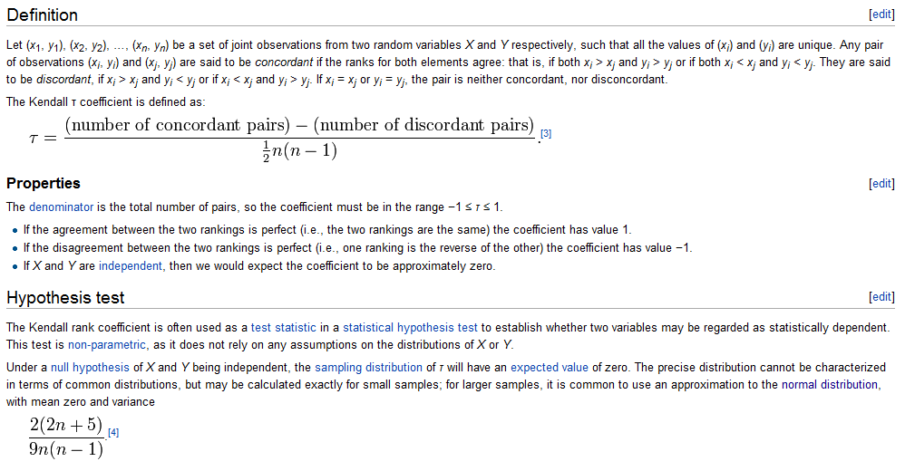
http://en.wikipedia.org/wiki/Kendall_tau_rank_correlation_coefficient

Slide 4
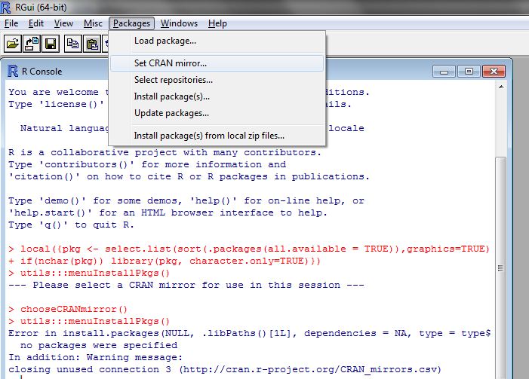
This test is not part of the main distribution in R…

Slide 5
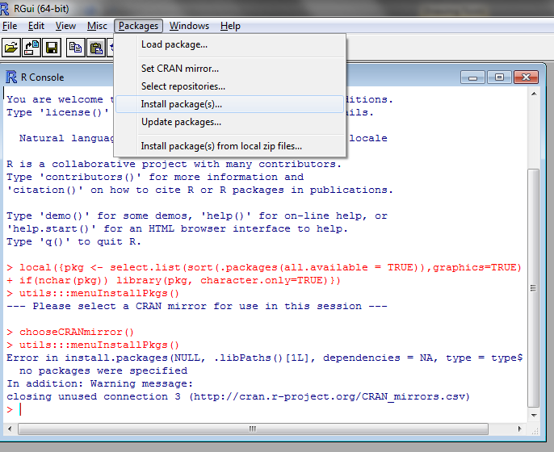

Slide 6
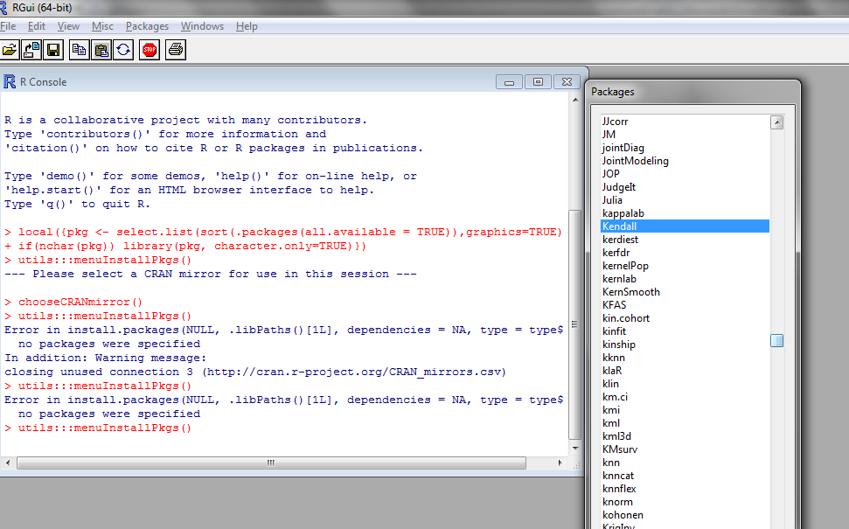
Choose Kendall and click “OK”.

Slide 7
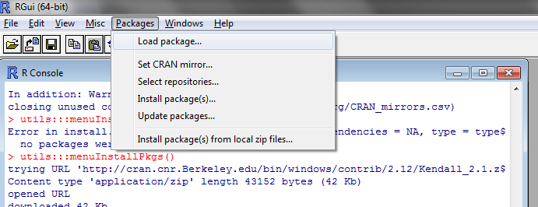
Every time you start R, you have to load the package

Slide 8
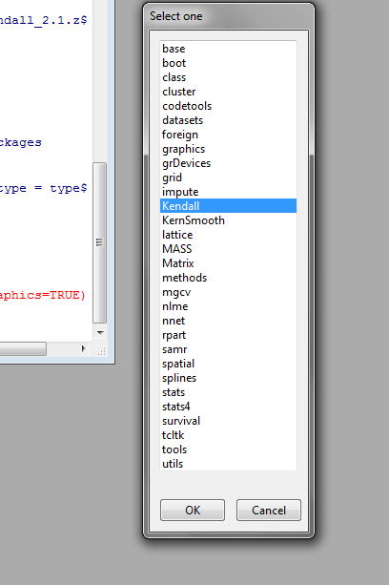

Slide 9
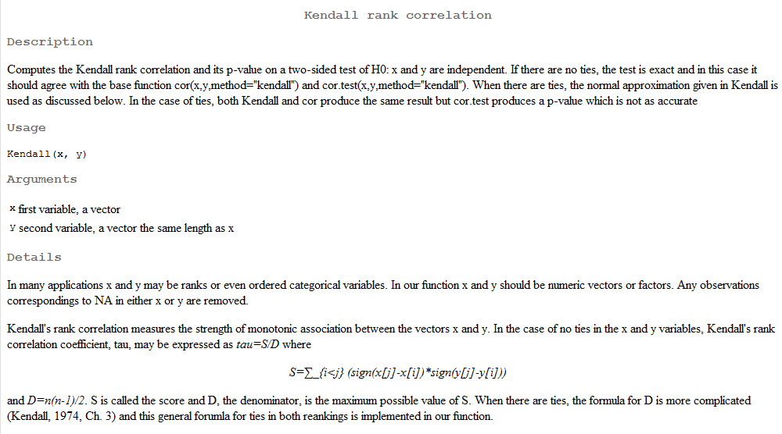
When everything is installed, “?Kendall” will yield this help file….

Slide 10
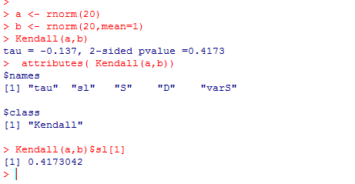

Slide 11
Kenall’s tau
Subsitution Matrices

Slide 12

Here we follow the Durbin et al. book…

Slide 13
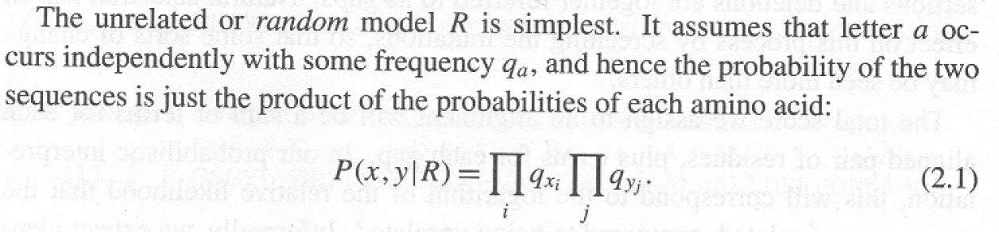
Consider some protein alignment….
ELVIS-
ELVIRA
How do we score this alignment?
How do we generate it?
This our background model.
The probability of any alignment given just “rolling” the sequences of the alignment with a 20 sided die where the odds of getting any aa is the frequency of that residue in our training set (PFAM, SWISS-PROT, whatever)

Slide 14
The background frequencies in SwissProt…
public static final char[] RESIDUES = new char[] { 'A', 'C', 'D', 'E', 'F', 'G', 'H', 'I', 'K', 'L', 'M', 'N', 'P', 'Q', 'R', 'S', 'T',
'V', 'W', 'Y' };
public static float BACKGROUND[] =
{0.072658f, 0.024692f, 0.050007f, 0.061087f,
0.041774f, 0.071589f, 0.023392f, 0.052691f, 0.063923f,
0.089093f, 0.023150f, 0.042931f, 0.052228f, 0.039871f,
0.052012f, 0.073087f, 0.055606f, 0.063321f, 0.012720f,
0.032955f};

Slide 15
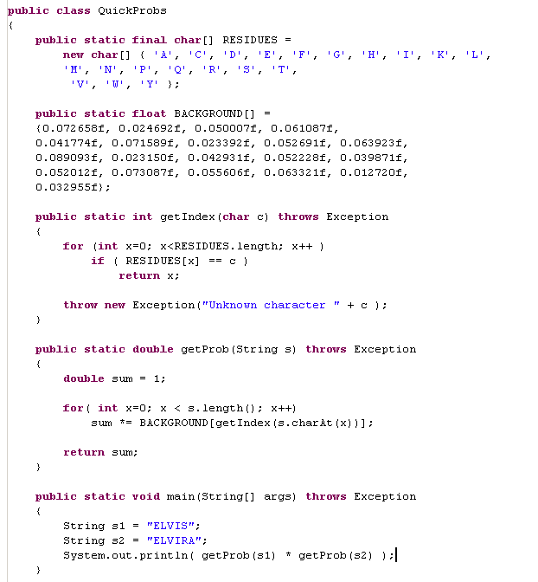
ELVIS-
ELVIRA
P(x,y|RandomModel) = P(x,y|R)

Slide 16
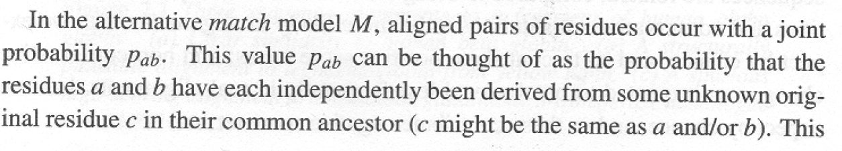
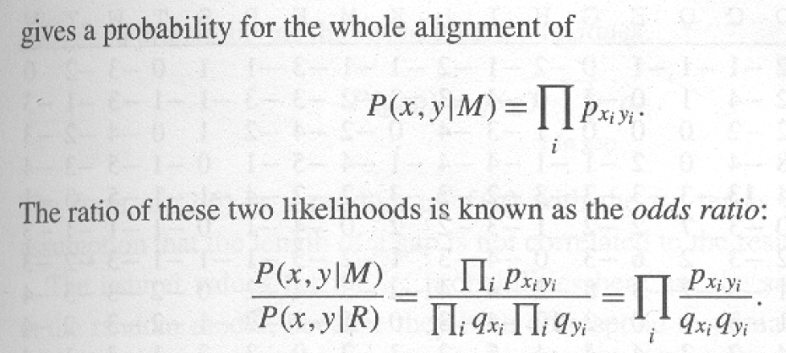
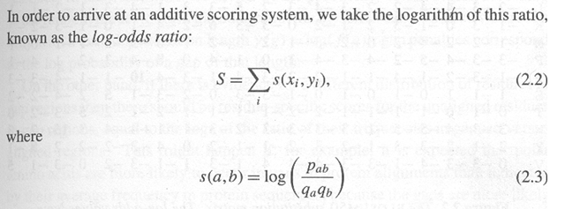
By itself, the random model is not very interesting, but it is part of the log-odds ratio…
This provides the definition of a substitution matrix

Slide 17
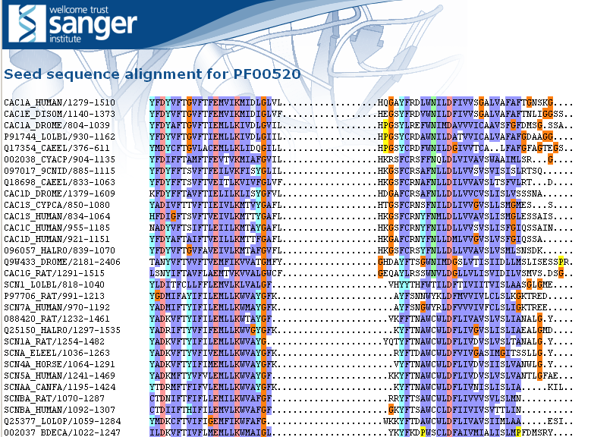
Let’s calculate p(x,y|M) naively
We’ll define p(x,y|M) as the frequency of seeing a pair of residues aligned against each other from the first 25 pfam families…
Considering all pairwise sequences in the alignment, how often do we see each substitution?

Slide 18
Let’s calculate p(x,y|M) naively
We’ll define p(x,y|M) as the frequency of seeing a pair of residues aligned against each other from the first 25 pfam families…
Considering all pairwise sequences in the alignment, how often do we see each substitution?

Slide 19
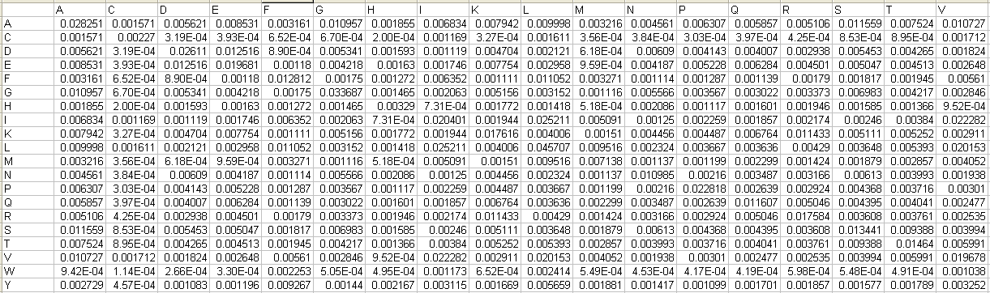
And here is (part of our) triangle
These are the probs
dervied from our
Alignments.
“A to A” is observed as 0.028251
of all pairs in the alignment..
For any pair of residues in an alignment, we have the top and the bottom
calculated
We are now ready to derive our simple substitution matrix….

Slide 20
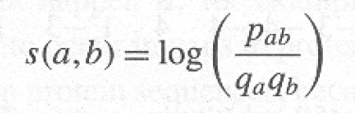
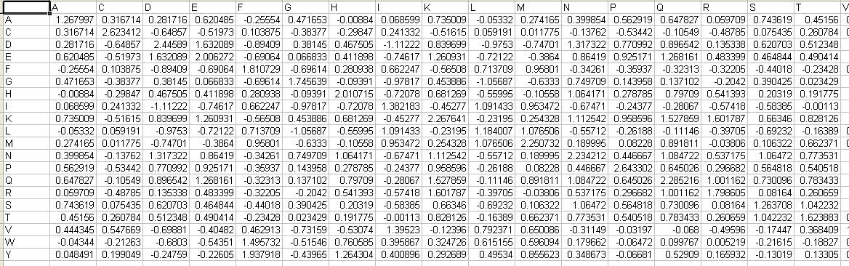
Here is (part of our) substitution matrix triangle

Slide 21
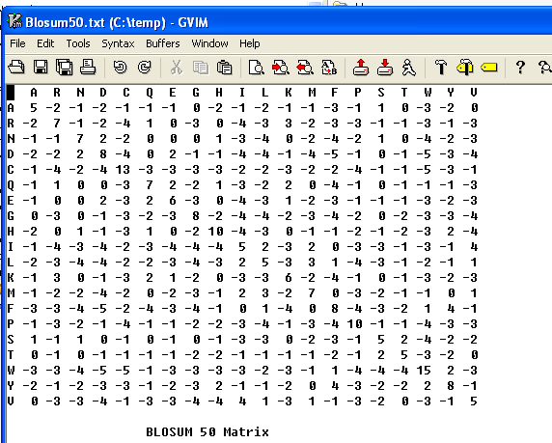
How does our naïve substitution matrix compare to a real one?
(E.g. Blosum50?)

Slide 22
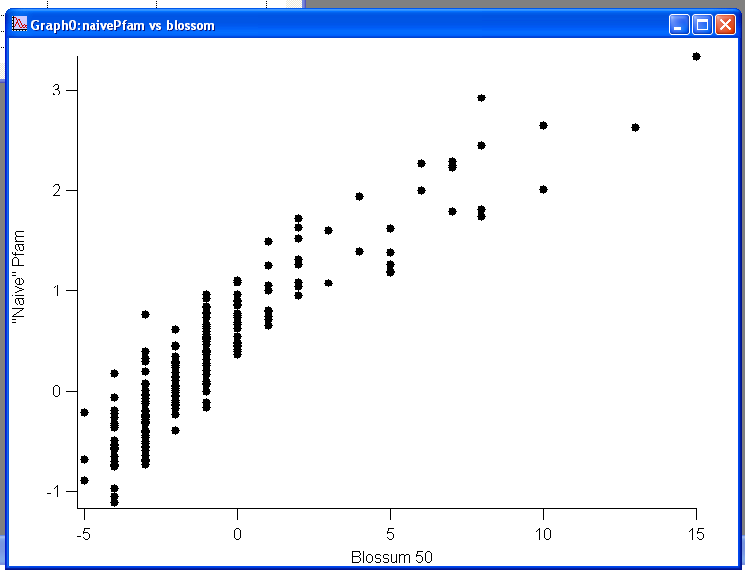
Our “naïve” substitution matrix, not so different from Blossum!
Of course, we are just “rediscovering” the substitution matrix PFAM uses…

Slide 23
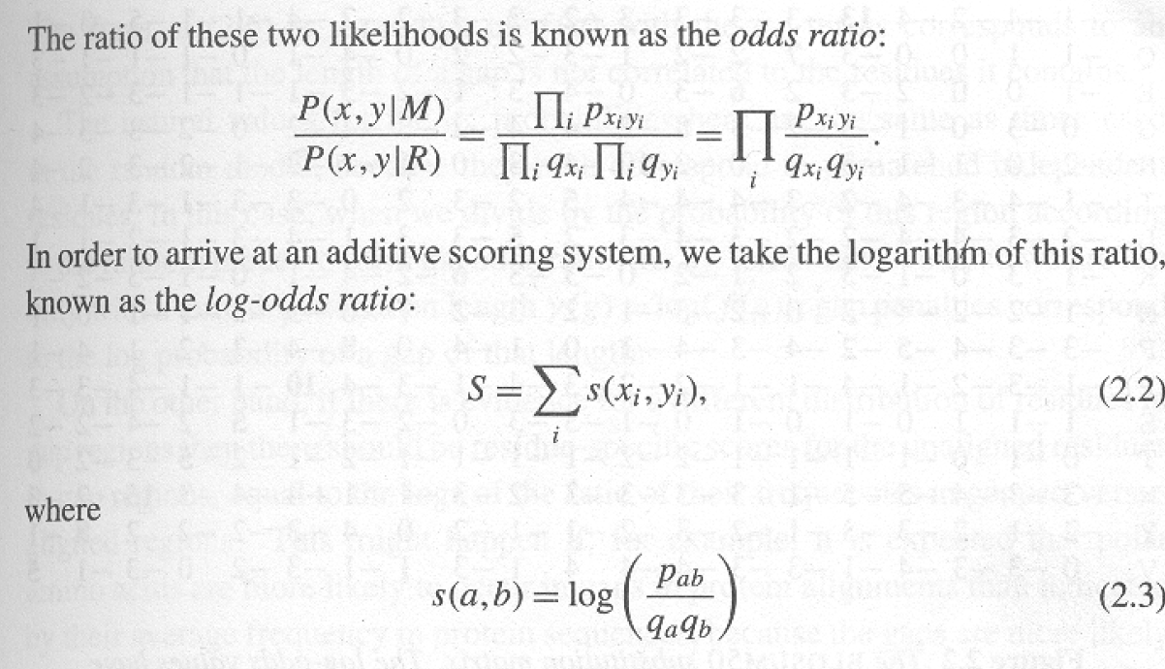
A substitution matrix is just a description of a training set
What you expect from matched residues
s(a,b) = log
What you expect from unmatched residues
If s(a,b) is positive, the substitution is more likely to happen than chance.
If s(a,b) is negative, the substitution is less likely to happen than chance.

Slide 24
This is the “score” of the alignment…

Slide 25
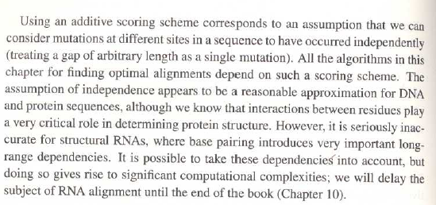
A key assumption is independence. What happens in one
part of the sequence does not effect another..
This is a terrible assumption for structural RNA…

Slide 26
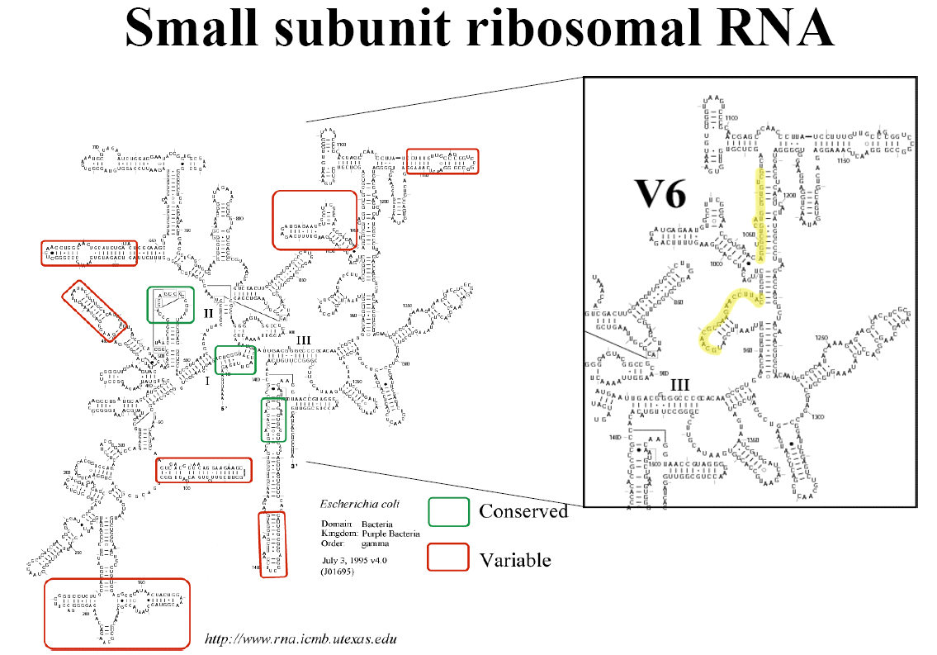
This is a terrible assumption for structural RNA…
Structural RNAs have their own alignment algorithms (which we
won’t talk about this semester…)

Slide 27
Next: Given a scoring function and two sequences, can we align
them to yield the highest score possible under the scoring function?

